Slide 1

Cloud Computing
MAP REDUCE
Simplified Data Processing on Large Clusters

Slide 2
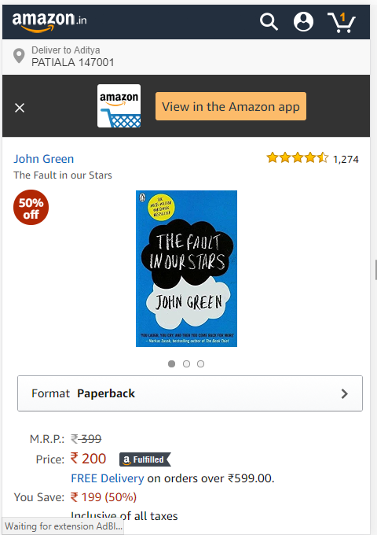
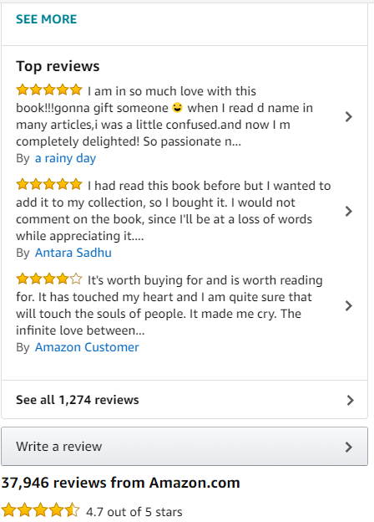
The Amazon Problem
37,946
REVIEWS !!
Buying on Amazon ? Confused ??
Let’s Look at the reviews

Slide 3
Let’s have a glance at the reviews and get the crux out of them

Slide 4
To our rescue comes the Map Reduce Algorithm
Imagine if there were 8 crore reviews to be Analyzed !
That’s the real number of reviews Amazon servers deal with every day.

Slide 5





Problem Statement

Slide 6
AIM AND UTILITY
The aim of this project is to design and develop an Internship portal, on which End users can search Internships & apply online for a specific Internship.
Companies can also post their Internships to hire interns for their company.

Slide 7
AIM AND UTILITY
This portal will be specified only for Internships. Online business on this portal is beyond the scope of this project.
Internship seekers can search and apply online for Internships related to their fields within specific area and stipend.

Slide 8
Technology
Front End
HTML , CSS
BOOTSTRAP
Back End
PHP
MySQL
For Designing Work: Adobe Photoshop | Illustrator

Slide 9
Architecture

Slide 10
Roles
Aditya Ghodgaonkar
Reetika Pahuja
Aprajita Thakur
UI Designer
Back end Development
Back End Development
UI Designer
Content Developer
UX Designer

Slide 11
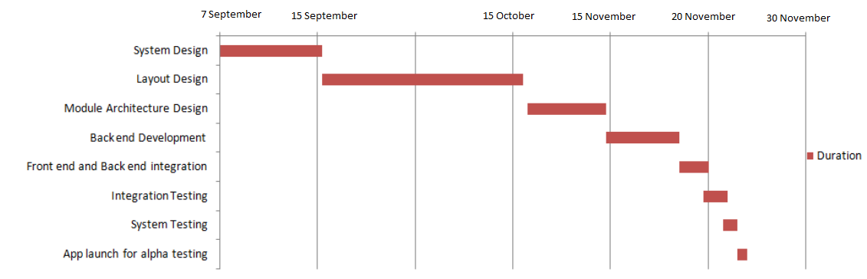
Gantt Chart

Slide 12
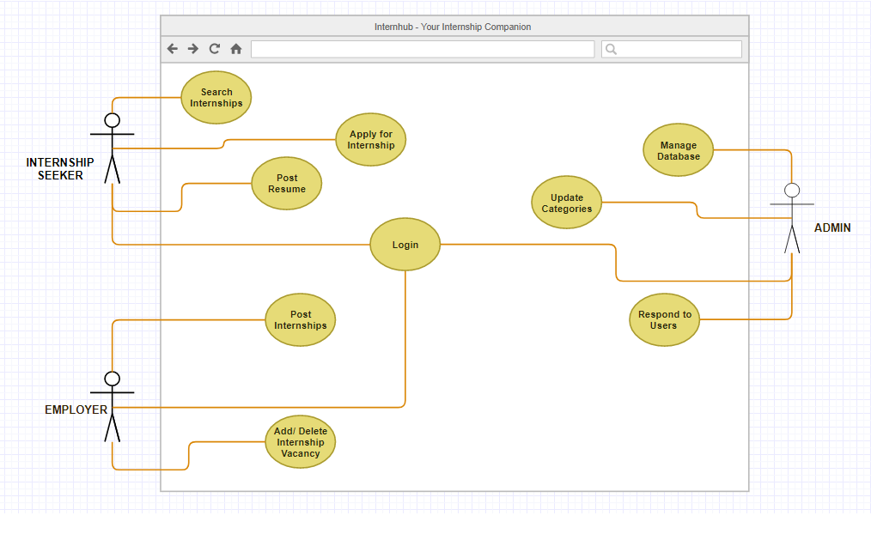
USE CASE DIAGRAM

Slide 13
Future Aspect
Internhub will revamp the Internship Experience. In future, this platform could be used for seeking not just Internships but Projects, Cumulative Research Participation.
Also, we promise to bring a PWA version of our Web Application which will empower the Application on even those systems and mobile phones which aren't that good when it comes to Internet Connectivity.

Slide 14
Thank You for the Patience !!

